Slide 1

Management
15th Edition, Global Edition
Capítulo 3
Influência do ambiente externo e a cultura organizacional
Copyright © 2018 Pearson Education, Ltd. All Rights Reserved

Slide 2
Objetivos
7.1 Contrastar as ações dos gestores de acordo com a perspetiva da omnipotência e a perspetiva simbólica.
7.2 Descrever os condicionamentos e os desafios que os gestores enfrentam no ambiente externo atual.
7.3 Descrever as características e a importância da cultura organizacional.
7.4 Conhecer os tópicos atuais da cultura organizacional.

Slide 3
O Gestor:
Omnipotente ou Simbólico?
Perspetiva da omnipotência
Os gestores são diretamente responsáveis pelo sucesso ou fracasso das organizações.
Perspetiva simbólica da gestão
O sucesso ou fracasso da organização depende de fatores que estão fora do controlo dos gestores.
Notes:
How much difference does a manager make in how an organization performs? The dominant view in management theory and society in general is that managers are directly responsible for an organization’s success or failure. We call this perspective the omnipotent view of management. In contrast, others have argued that much of an organization’s success or failure is due to external forces outside managers’ control. This perspective is called the symbolic view of management.

Slide 4
Condicionantes às possibilidade de ação e decisão dos gestores
Na realidade os gestores não são nem omnipotentes nem impotentes. Mas as suas decisões e ações, e respetivos resultados, são condicionadas.
A Figura seguinte mostra que as condicionantes externas dizem respeito ao ambiente da organização e as condicionantes internas dizem respeito à cultura organizacional.
Notes:
In reality, managers are neither all-powerful nor helpless. But their decisions and actions are constrained. As you can see in Exhibit 7-1, external constraints come from the organization’s environment and internal constraints come from the organization’s culture.

Slide 5
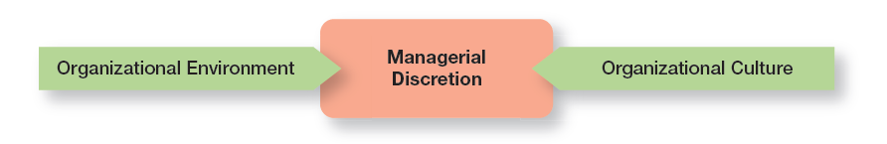
Condicionantes às possibilidade de ação e decisão dos gestores

Slide 6
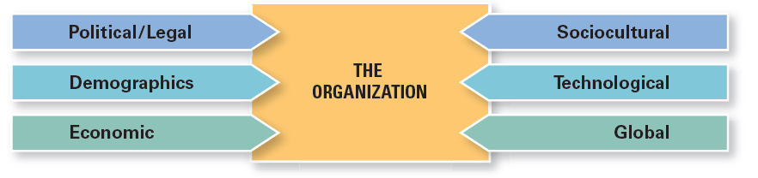
Figura 7-2
Componentes do ambiente Externo
Notes:
The economic component encompasses factors such as interest rates, inflation, changes in disposable income, stock market fluctuations, and business cycle stages.
The demographic component is concerned with trends in population characteristics such as age, race, gender, education level, geographic location, income, and family composition.
The political/legal component looks at federal, state, and local laws as well as global laws and laws of other countries. It also includes a country’s political conditions and stability.
The sociocultural component is concerned with societal and cultural factors such as values, attitudes, trends, traditions, lifestyles, beliefs, tastes, and patterns of behavior.
The technological component is concerned with scientific or industrial innovations.
The global component encompasses those issues associated with globalization and a world economy.

Slide 7
Analisar a incerteza ambiental
A incerteza ambiental diz respeito ao grau de mudança e de complexidade no ambiente da organização.
  A primeira dimensão da incerteza é o grau de mudança.
    Se as componentes do ambiente externo são estáveis, o grau de mudança é mínimo.
    Se as componentes do ambiente externo são dinâmicas, o grau de mudança é frequente.
  A segunda dimensão é a complexidade ambiental – número de componentes no ambiente e conhecimento que a organização tem sobre esses componentes. Assim, o ambiente pode ser simples ou complexo.
Notes:
The first dimension of uncertainty is the degree of change. If the components in an organization’s environment change frequently, it’s a dynamic environment. If change is minimal, it’s a stable one. A stable environment might be one with no new competitors, few technological breakthroughs by current competitors, little activity by pressure groups to influence the organization, and so forth. When we talk about degree of change, we mean change that’s unpredictable. If change can be accurately anticipated, it’s not an uncertainty for managers.
The other dimension of uncertainty describes the degree of environmental complexity, which looks at the number of components in an organization’s environment and the extent of the knowledge that the organization has about those components. An organization with fewer competitors, customers, suppliers, government agencies, and so forth faces a less complex and uncertain environment. Complexity is also measured in terms of the knowledge an organization needs about its environment.

Slide 8
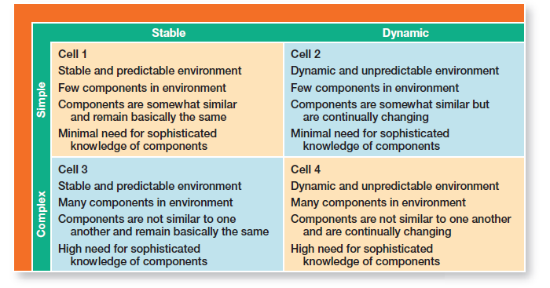
Figura 7-3
Matriz de incerteza ambiental
Notes:
Environmental uncertainty refers to the degree of change and complexity in an organization’s environment. The matrix in Exhibit 7-3 shows these two aspects.
Looking at Exhibit 7-3, each of the four cells represents different combinations of degree of complexity and degree of change. Cell 1 (stable and simple environment) represents the lowest level of environmental uncertainty and cell 4 (dynamic and complex environment) the highest. Not surprisingly, managers have the greatest influence on organizational outcomes in cell 1 and the least in cell 4. Because uncertainty poses a threat to an organization’s effectiveness, managers try to minimize it.

Slide 9
O Ambiente Específico (1 of 2)
Ambiente Específico : A parte do meio envolvente que é diretamente relevante para a organização atingir os seus objetivos
A gestão direciona a sua atenção maioritariamente para o ambiente específico da sua organização.
Notes:
The specific environment consists of those external constituencies or stakeholders that can affect the organization in some way.

Slide 10
O Ambiente Específico (2 of 2)
O ambiente específico incluí:
  Fornecedores
  Clientes
  Concorrentes
  Agências governamentais
  Grupos de Interesses (são vários)
Notes:
The nature of stakeholder relationships is another way in which the environment influences managers. The more obvious and secure these relationships, the more influence managers will have over organizational outcomes.
Stakeholders are any constituencies in the organization’s environment affected by an organization’s decisions and actions. These groups have a stake in or are significantly influenced by what the organization does. In turn, these groups can influence the organization.
Management researchers who have looked at this issue are finding that managers of high-performing companies tend to consider the interests of all major stakeholder groups as they make decisions.

Slide 11
Componentes do Ambiente Específico
Fornecedores: Os gestores precisam de garantir um fluxo contínuo e previsível de inputs
Clientes: As organizações existem para ir de encontro às necessidades dos seus cliente e/ou beneficiários.
Concorrentes: Quase todas as organizações têm concorrentes que precisam de monitorar.
Governo: O governo ao nível federal, estadual, regional e local influencia o que organização pode e não pode fazer.
Grupos de interesse / pressão: Estes grupos podem ter um impacto significativo no funcionamento da organização, quer pelo protesto e disrupção das suas atividades quer pelo potencial de publicidade negativa que exercer. Exemplos: Lobbyists, sindicatos, associações profissionais, organizações ambientalistas, etc.
Notes:
Managers need to monitor each of these components and be ready to respond to changes. For example, even monopolies like the US Postal Service discovered it had competitors in FedEx and UPS. Ignoring competitors can cost market share and threaten long-term survival.

Slide 12
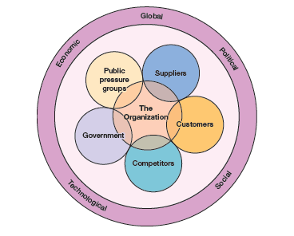
Componentes do Ambiente Específico
Notes:
As you can see there are a lot of moving parts that managers need to keep track of and be ready to respond to or to proactively respond to potential threats.
Long Description:
The chart shows “Organization” in the center. The entities of the environment placed around the “Organization” are as follows.
Suppliers
Customers
Competitors
Government
Public pressure groups
A circle surrounds the organization and the five entities. The organization influencing factors listed on the circle are as follows.
Economic
Global
Political
Social
Technological

Slide 13
Gestão do relacionamento com os stakeholders (designação genérica para os agentes do ambiente específico da organização)
A natureza das relações com os stakeholders pode afetar o modo como o ambiente influencia os gestores.
Se as relações forem conhecidas e estáveis, os gestores têm maior possibilidade de ter impacto nos resultados da organização.
Stakeholders - qualquer entidade ou grupo de pessoas, no ambiente externo e interno da organização, que pode ser afetado pelas decisões e ações da organização.
A Figura seguinte identifica alguns dos stakeholders mais habituais.
Notes:
The nature of stakeholder relationships is another way in which the environment influences managers. The more obvious and secure these relationships, the more influence managers will have over organizational outcomes.
Stakeholders are any constituencies in the organization’s environment affected by an organization’s decisions and actions. These groups have a stake in or are significantly influenced by what the organization does. In turn, these groups can influence the organization.
Management researchers who have looked at this issue are finding that managers of high-performing companies tend to consider the interests of all major stakeholder groups as they make decisions.

Slide 14
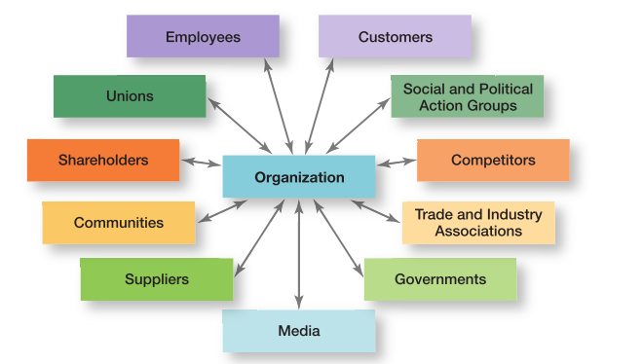
Stakeholders
Notes:
Exhibit 7-4 identifies some of an organization’s most common stakeholders. Note that these stakeholders include internal and external groups. Why? Because both can affect what an organization does and how it operates. For instance, the Dodd-Frank Act requires that many U.S. companies report their executives’ compensation in publicly available sources and in a manner that can be easily comprehended by the public at large. How would this information affect stakeholders?

Slide 15
Benefícios de um bom relacionamento com os stakeholders
Maior previsibilidade das mudanças ambientais.
Aumento das inovações bem sucedidas.
Aumento da confiança dos stakeholders.
Maior flexibilidade organizacional, reduzindo o impacto da mudança.
Notes:
Another reason for managing external stakeholder relationships is that it’s the “right” thing to do. Because an organization depends on these external groups as sources of inputs (resources) and as outlets for outputs (goods and services), managers need to consider their interests as they make decisions.

Slide 16
Cultura Organizacional
Tal como cada indivíduo tem uma personalidade única, cada organização também tem a sua personalidade.
“A key to success in management and in your career is knowing how to “read” an organization’s culture so you can find one in which you’ll be happy.”
* Sem demasiado romantismo! (Empreendedorismo)
Notes:
Just as each individual has a unique personality—traits and characteristics influence the way we act and interact with others. An organization, too, has a personality, which is referred to as organizational culture.
An organization’s culture can make employees feel included, empowered, and supported or it can make them feel the opposite.
Because culture can be a very powerful agent in organizations, it is very important for managers to pay attention to it.

Slide 17
Cultura organizacional
Google
https://www.youtube.com/watch?v=n_Cn8eFo7u8
Mahle (Japan)
https://www.youtube.com/watch?v=Auo-ytfuamw
Karoshi - Problemas relacionados com a cultura organizacional no Japão
https://www.youtube.com/watch?v=Y0-jpm5l_dY

Slide 18
O que é a Cultura Organizational?
Cultura Organizacional – conjunto partilhado de valores, princípios, tradições e práticas que influenciam o modo como os membros de uma organização atuam.
Culturas fortes – culturas em que os valores principais são intensamente interiorizados e largamente partilhados.
A investigação sugere que existem sete dimensões que podem descrever a essência da cultura organizacional. A Figura seguinte mostra estas dimensões.
Notes:
In most organizations, these shared values and practices have evolved over time and determine, to a large extent, how “things are done around here.”
Our definition of culture implies three things. First, culture is a perception. It’s not something that can be physically touched or seen, but employees perceive it on the basis of what they experience within the organization. Second, organizational culture is descriptive. It’s concerned with how members perceive the culture and describe it, not with whether they like it. Finally, even though individuals may have different backgrounds or work at different organizational levels, they tend to describe the organization’s culture in similar terms. That’s the shared aspect of culture.
Strong cultures have a greater influence on employees than weaker cultures. (Exhibit 7-7 contrasts strong and weak cultures.)
The more employees accept the organization’s key values and the greater their commitment to those values, the stronger the culture. Most organizations have moderate to strong cultures; that is, there is relatively high agreement on what’s important, what defines “good” employee behavior, what it takes to get ahead, and so forth. The stronger a culture becomes, the more it affects the way managers plan, organize, lead, and control.

Slide 19
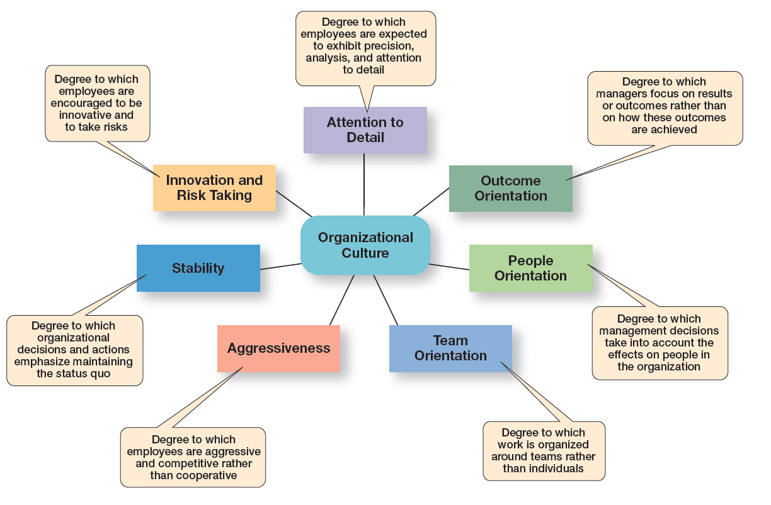
Dimensões da cultura organizacional
Notes:
Research suggests seven dimensions that seem to capture the essence of an organization’s culture. These dimensions (shown in Exhibit 7-5) range from low to high, meaning it’s not very typical of the culture (low) or is very typical of the culture (high). Describing an organization using these seven dimensions gives a composite picture of the organization’s culture.

Slide 20
Questão 04:
(Responda p.f. através do Ms Teams)
Com que dimensão da cultura organizacional você mais se identifica (i.e., que cultura você gostaria de encontrar na sua organização)?
1. Atenção ao detalhe
2. Orientação para os resultados
3. Orientação para as pessoas
4. Orientação para a(s) equipa(s)
5. Agressividade/competitividade
6. Estabilidade e manutenção do status quo
7. Inovação e aceitação do risco

Slide 21
Dimensões da cultura organizacional
Inovação e risco – grau em que os empregados são encorajados a ser inovadores e a correr riscos.
Atenção ao detalhe - grau de importância atribuída à precisão, à análise, e ao detalhe.
Orientação para os resultados - grau de importância atribuída aos resultados, por oposição aos processos utilizados para os atingir.
Orientação para as pessoas – grau em que os gestores têm em consideração os efeitos que as decisões terão sobre as pessoas da organização.
Notes:
In many organizations, one cultural dimension often is emphasized more than the others and essentially shapes the organization’s personality and the way the organization works. Exhibit 7-6 describes how the dimensions can create significantly different cultures.

Slide 22
Dimensões da cultura organizacional
Orientação para as equipas – grau em que as atividades de trabalho são organizadas e atribuídas a equipas e não a indivíduos.
Agressividade – grau em que as pessoas são agressivas e competitivas, por oposição a tranquilas e cooperantes, entre si.
Estabilidade – grau em que as atividades organizacionais enfatizam a manutenção do status quo (modos atuais de agir) ou, por oposição, promovem a rápida adaptação e crescimento da organização.
Notes:
In many organizations, one cultural dimension often is emphasized more than the others and essentially shapes the organization’s personality and the way the organization works. Exhibit 7-6 describes how the dimensions can create significantly different cultures.

Slide 23
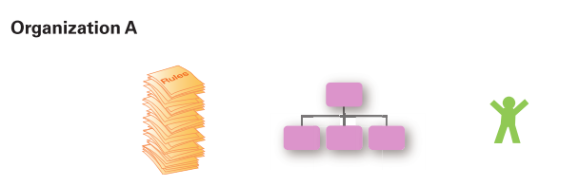
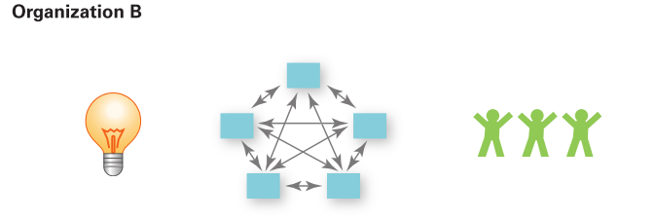
Diferentes exemplos de culturas organizacionais
Risk-taking and change discouraged
Creativity discouraged
Close managerial supervision
Work designed around individual employees
Risk-taking and change rewarded
Creativity and innovation rewarded
Management trusts employees
Work designed around teams
Notes:
Exhibit 7-6 illustrates how the dimensions of culture can create significantly different cultures.
Both Organization A and Organization B are manufacturing firms, but each company emphasizes a different dimension that have shaped organizational culture.

Slide 24
Figura 7-7
Culturas fortes e culturas fracas
Strong Cultures | Weak Cultures
Values widely shared | Values limited to a few people – usually top management
Culture conveys consistent messages about what’s important | Culture sends contradictory messages about what’s important
Most employees can tell stories about company history or heroes | Employees have little knowledge of company history or heroes
Employees strongly identify with culture | Employees have little identification with culture
Strong connection between shared values and behaviors | Little connection between shared values and behaviors
Notes:
Why is having a strong culture important? For one thing, in organizations with strong cultures, employees are more loyal than employees in organizations with weak cultures.
Research also suggests that strong cultures are associated with high organizational performance. However, the drawback is that a strong culture also might prevent employees from trying new approaches, especially when conditions change rapidly.

Slide 25
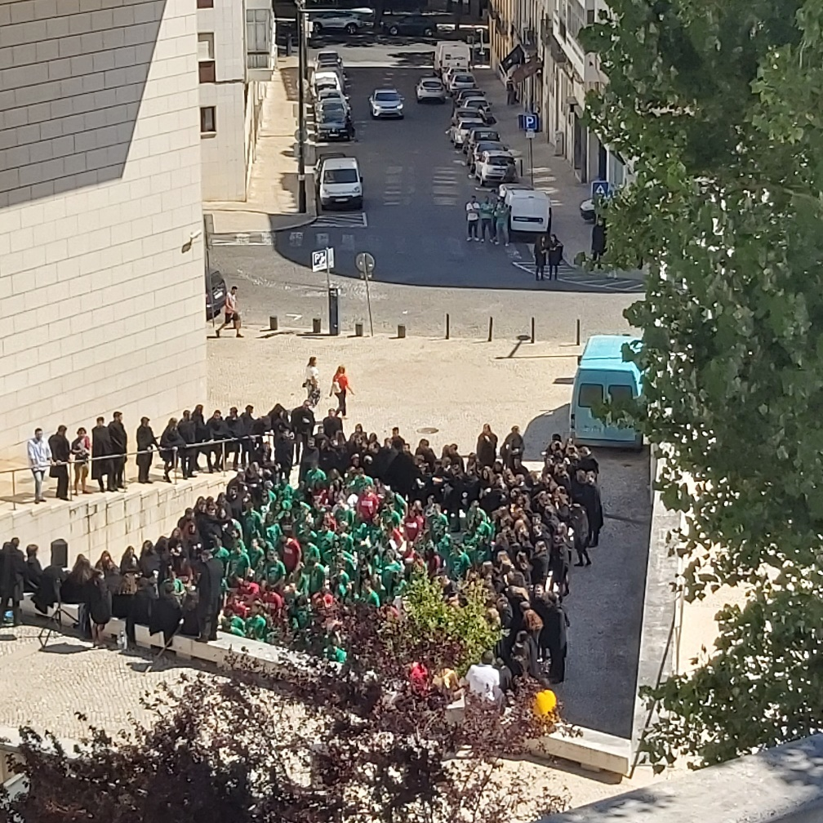
Como aparece e se mantém a cultura organizacional
Fundadores da empresa
Visão e missão
Critérios de seleção
Comportamento dos gestores de topo
Socialização
Processo que ajuda os membros a aprenderem a cultura organizacional.
Notes:
Company founders are not constrained by previous customs or approaches and can establish the early culture by articulating a vision of what they want the organization to be. Also, the small size of most new organizations makes it easier to instill that vision with all organizational members.
Once the culture is in place, however, certain organizational practices help maintain it. For instance, during the employee selection process, managers typically judge job candidates not only on the job requirements, but also on how well they might into the organization. At the same time, job candidates find out information about the organization and determine whether they are comfortable with what they see.
Through what they say and how they behave, top managers establish norms that filter down through the organization and can have a positive effect on employees’ behaviors. For instance, Gravity CEO, Dan Price, raised the minimum wage at his firm to $70,000 annually and has cut his million dollar salary to fund those pay increases. Since making this decision, Gravity’s financial performance has soared.
However, as we’ve seen in numerous corporate ethics scandals, the actions of top managers also can lead to undesirable outcomes.

Slide 26
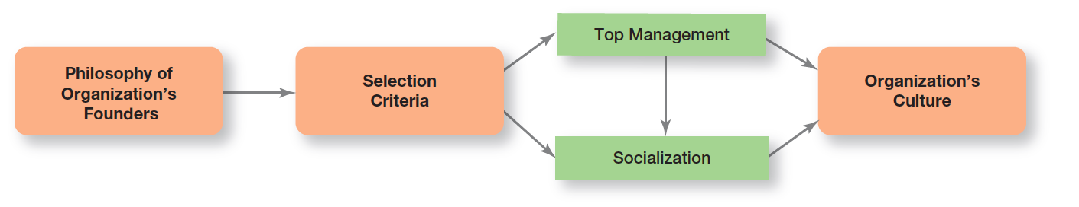
Estabelecer e manter a cultura
Notes:
Exhibit 7-8 illustrates how an organization’s culture is established and maintained.

Slide 27
Como é que os empregados aprendem a cultura?
Histórias (datas marcantes, heróis e mártires)
Rituais (cerimónias, festas)
Linguagem (formalidade/informalidade, termos próprios)
Símbolos (decoração, vestuário, logotipo)
Valores (declaração explicita)
Notes:
Organizational “stories” typically contain a narrative of significant events or people, including such things as the organization’s founders, rule breaking, reactions to past mistakes, and so forth. To help employees learn the culture, organizational stories anchor the present in the past, provide explanations and legitimacy for current practices, exemplify what is important to the organization, and provide compelling pictures of an organization’s goals.
Corporate rituals are repetitive sequences of activities that express and reinforce the important values and goals of the organization. One of the best-known corporate rituals is Mary Kay Cosmetics’ annual awards ceremony for its sales representatives.
The layout of an organization’s facilities, how employees dress, the types of automobiles provided to top executives, and the availability of corporate aircraft are examples of material symbols. Others include the size of offices, the elegance of furnishings, executive “perks” (extra benefits provided to managers such as health club memberships, use of company-owned facilities, and so forth), employee fitness centers or on-site dining facilities, and reserved parking spaces for certain employees.
Many organizations and units within organizations use language as a way to identify and unite members of a culture. Over time, organizations often develop unique terms to describe equipment, key personnel, suppliers, customers, processes, or products related to its business. New employees are frequently overwhelmed with acronyms and jargon that, after a short period of time, become a natural part of their language. Once learned, this language acts as a common denominator that bonds members.

Slide 28
Como é que a cultura afeta o trabalho dos gestores
  Quais as ações consideradas como corretas ou incorretas.
  Quais as atividades e comportamentos que a organização valoriza e encoraja.
  As culturas fortes têm mais impacto nas práticas e comportamentos de gestão, do que as culturas fracas.
Notes:
Such constraints are rarely explicit. They’re not written down. It’s unlikely they’ll even be spoken. But they’re there, and all managers quickly learn what to do and not do in their organization.
The link between values such as these and managerial behavior is fairly straightforward. Take, for example, a so-called “ready-aim- re” culture. In such an organization, managers will study and analyze proposed projects endlessly before committing to them. However, in a “ready- re-aim” culture, managers take action and then analyze what has been done.

Slide 29
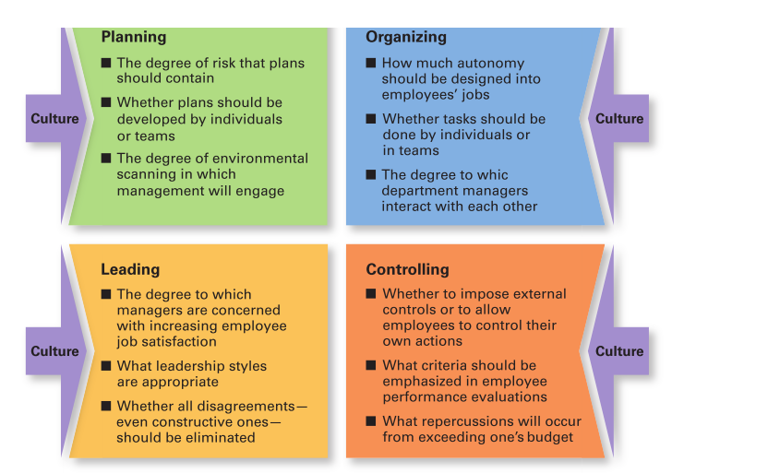
Tipos de decisões de gestão afetadas pela cultura
Notes:
As shown in Exhibit 7-9, a manager’s decisions are influenced by the culture in which he or she operates. An organization’s culture, especially a strong one, influences and constrains the way managers plan, organize, lead, and control.

Slide 30
Tópicos atuais sobre a cultura organizacional
Culturas orientadas para a inovação.
Culturas orientadas para o cliente.
Culturas orientadas para a sustentabilidade.

Slide 31
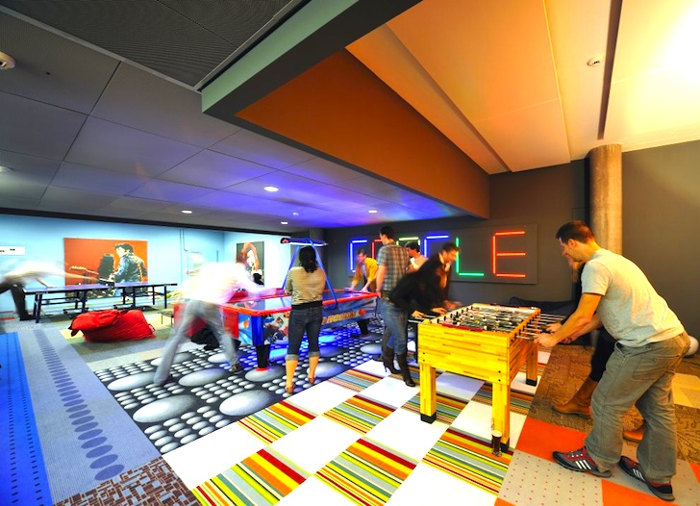
Cultura orientada para a inovação
  Desafio e envolvimento
  Liberdade
  Confiança e abertura
  Tempo para desenvolver ideias
  Humor
  Resolução de conflitos
  Debates
  Risco
Fonte da imagem: https://inhabitat.com/google-employees-in-zurich-zooglers-have-the-worlds-coolest-re-purposed-office/emea-engineering-hub-zurich-camenzind-evolution-1/
Notes:
How important is culture to innovation? In a survey of senior executives, over half said that the most important driver of innovation for companies was a supportive corporate culture. But not every company has established an adequate culture to foster innovation. In a survey of employees, about half expressed that a culture of management support is very important to the generation of innovative ideas, but only 20 percent believe that management actually provides such support.
What does an innovative culture look like? According to Swedish researcher Goran Ekvall, it would be characterized by the bullet points listed on the slide.

Slide 32
Cultura orientada para o cliente
Characteristics of Customer Responsive Culture | Suggestions for Managers
Type of employee | Hire people with personalities and attitudes consistent with customer service: friendly, attentive, enthusiastic, patient, good listening skills
Type of job environment | Design jobs so employees have as much control as possible to satisfy customers, without rigid rules and procedures
Empowerment | Give service-contact employees the discretion to make day-to-day decisions on job-related activities
Role clarity | Reduce uncertainty about what service-contact employees can and cannot do by continual training on product knowledge, listening, and other behavioral skills
Consistent desire to satisfy and delight customers | Clarify organization’s commitment to do whatever it takes, even if it’s outside an employee’s normal job requirements
Notes:
What does a customer-responsive culture look like? Exhibit 7-10 describes five characteristics of customer-responsive cultures and offers suggestions as to what managers can do to create that type of culture.

Slide 33
Cultura orientada para o cliente
Critérios de recrutamento e seleção incluem o interesse pelo cliente.
Regras, procedimentos, e regulamentos pouco rígidos.
Uso alargado de empowerment (autonomia e responsabilização).
Boas capacidades de escutar outros.
Clareza nas funções e papéis.
Empregados que são conscienciosos no desejo de agradar aos clientes.

Slide 34
Cultura orientada para a sustentabilidade
Em muitas organizações, a sustentabilidade é incluida na cultura organizacional.
Notes:
Companies can create rituals to create and maintain sustainability cultures. Earlier in this chapter, we referred to Convergint Technologies’ “Social Responsibility Day.” Alternatively, managers may use rewards. For instance, global polystyrene leader, Styron LLC, has more than 2,000 employees at 20 plants worldwide with annual sales of $5 billion. Management begins each corporate meeting with the topic of sustainability. Employees’ bonuses are tied to meeting sustainability goals. Management’s e orts seem to be working: Recently, Styron introduced a re-cycled-content grade of polycarbonate at the Chinaplas trade show in Guangzhou, China.

Slide 35
The End

